Slide 1
Introduction
Bright World
Supervisor:
Lê Thanh Nhân
Members:
Khưu Nguyễn Lan Anh – Student1352176
Huỳnh Thanh Tú – Student1357831
Nguyễn Minh Sơn – Student1352243
Vũ Đông Nam – Student1352239
Date… Month… Year …...

Slide 2
Content
Introduction
Actual requirements
Requirements of the project
Deployment diagram
Test result
Conclusion and development
Task list

Slide 3
Introduction - Actual requirements
Bright World company provides the light products of various types for different spaces and landscapes such as apartment balconies, gardens, restaurants, hotels, schools, etc..
With the desire to develop, the company understands that the demand for products not only comes from the local market but also the international market. A whole new website with fully functional will let our customers to access the products remotely, allowing us to reach out and expand our customer base. Not only does a website eliminate the need for opening multiple shops in different locations, it can also save money on leaflets and physical advertisements like bill boards and posters.

Slide 4
Introduction - Requirements of the project
Functional
For user :
- Can register a member and manage personal account
- Can view, compare and buy products
- Can search products by name or by price
- Can like for products
- Can view their orders and order history
Notes:
Non-functional (how the system works)
Functional (what the system should do)

Slide 5
Introduction - Requirements of the project
Functional
For admin :
- Can add/ edit admin’s account
- Can add/view/edit/deactivate products
- Can view all orders and change status orders
Notes:
Non-functional (how the system works)
Functional (what the system should do)

Slide 6
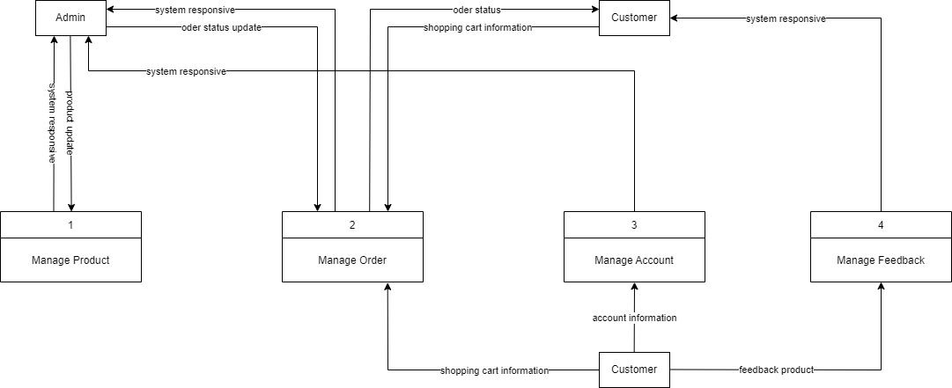
Introduction - Deployment diagram
Data Flow Diagram

Slide 7
Test Result
Functional | Table use | Actor | Status
Login Register Edit account information | Customer | Guest | Done
Search product by name Filter product Like product Add to cart product Order product | Product, Customer, Order | Guest | Done
View products liked View Order history | Product, Customer, Order | Guest | Done

Slide 8
Test Result
Functional | Table use | Actor | Status
Login | Admin | Admin | Done
Order Management | Order | Admin | Done
Admin’s account Management | Admin | Admin | Done
Product Management | Product | Admin | Done

Slide 9
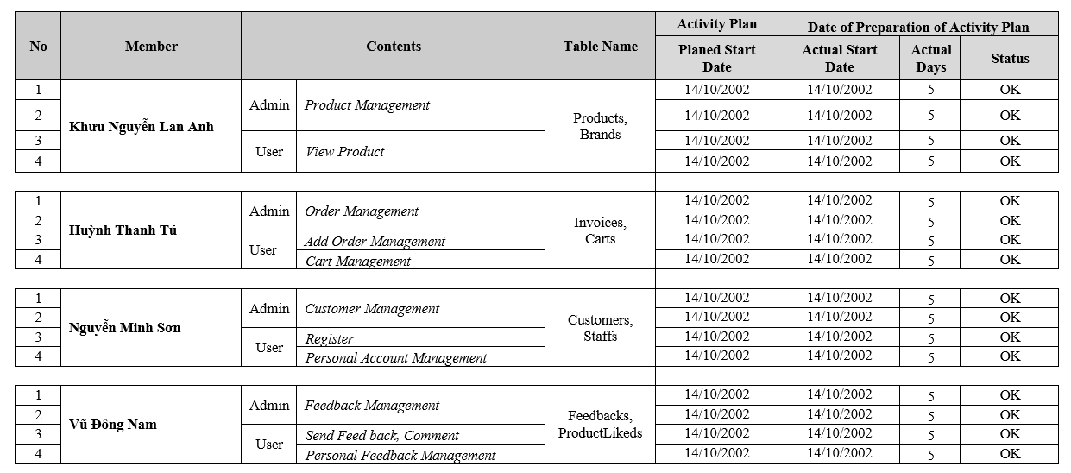
Task List

Slide 10

Thank You

